Slide 1
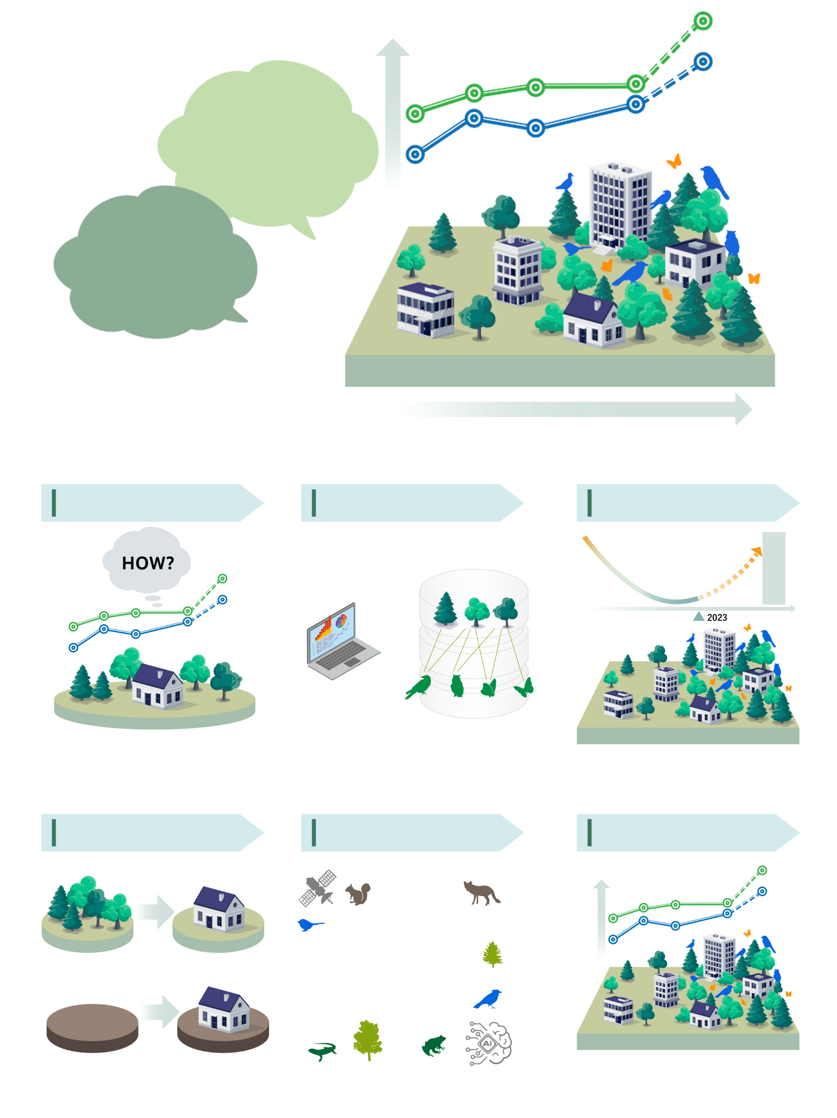

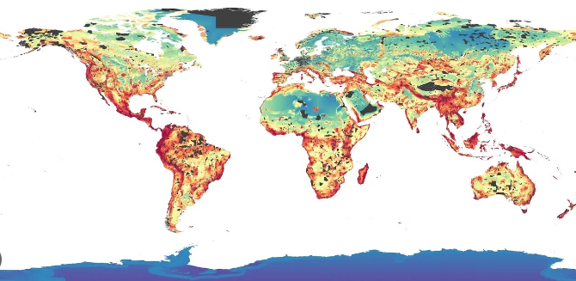
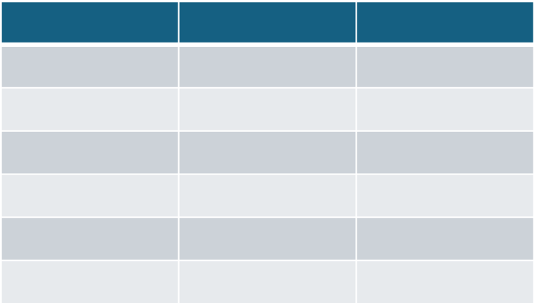
How to quantify net gains produced by green infrastructure?
How can our company conduct natural regeneration based on science?
Needs for regeneration
of nature on residential lots
Calculate restoration potential using species distribution data
Analise land use history in the focus locations
Data on animals using planted trees as habitat
Propose the best species composition for your location
Natural regeneration effects quantified

Slide 2
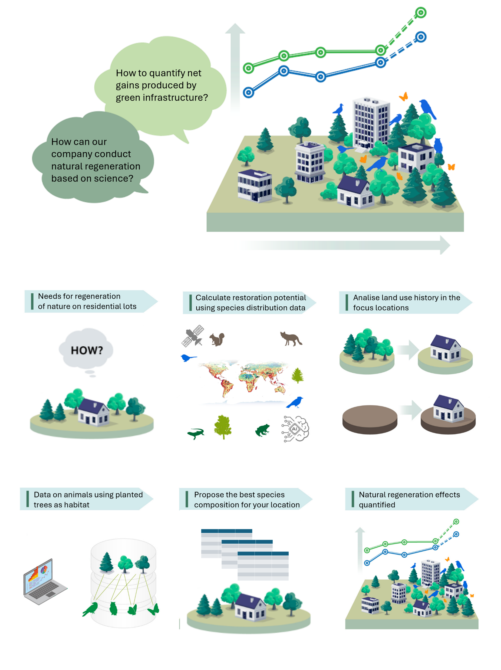



Slide 3
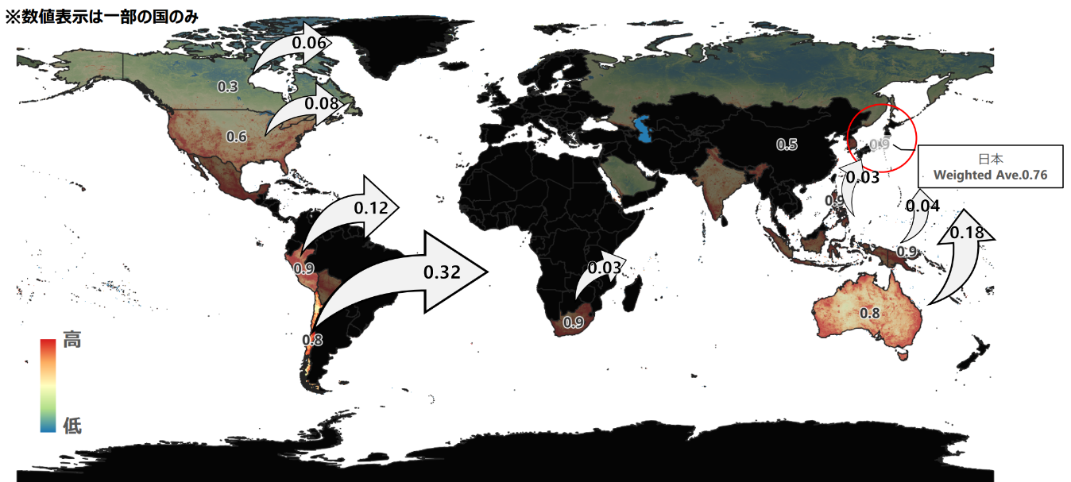

Weighted average of the mining sector's import destination countries overlaid with the biodiversity importance of the sector
Weighted avg.
JPN 0.76
Trade
Flow Rate
High
Biodiversity
Importance
Low

Slide 4
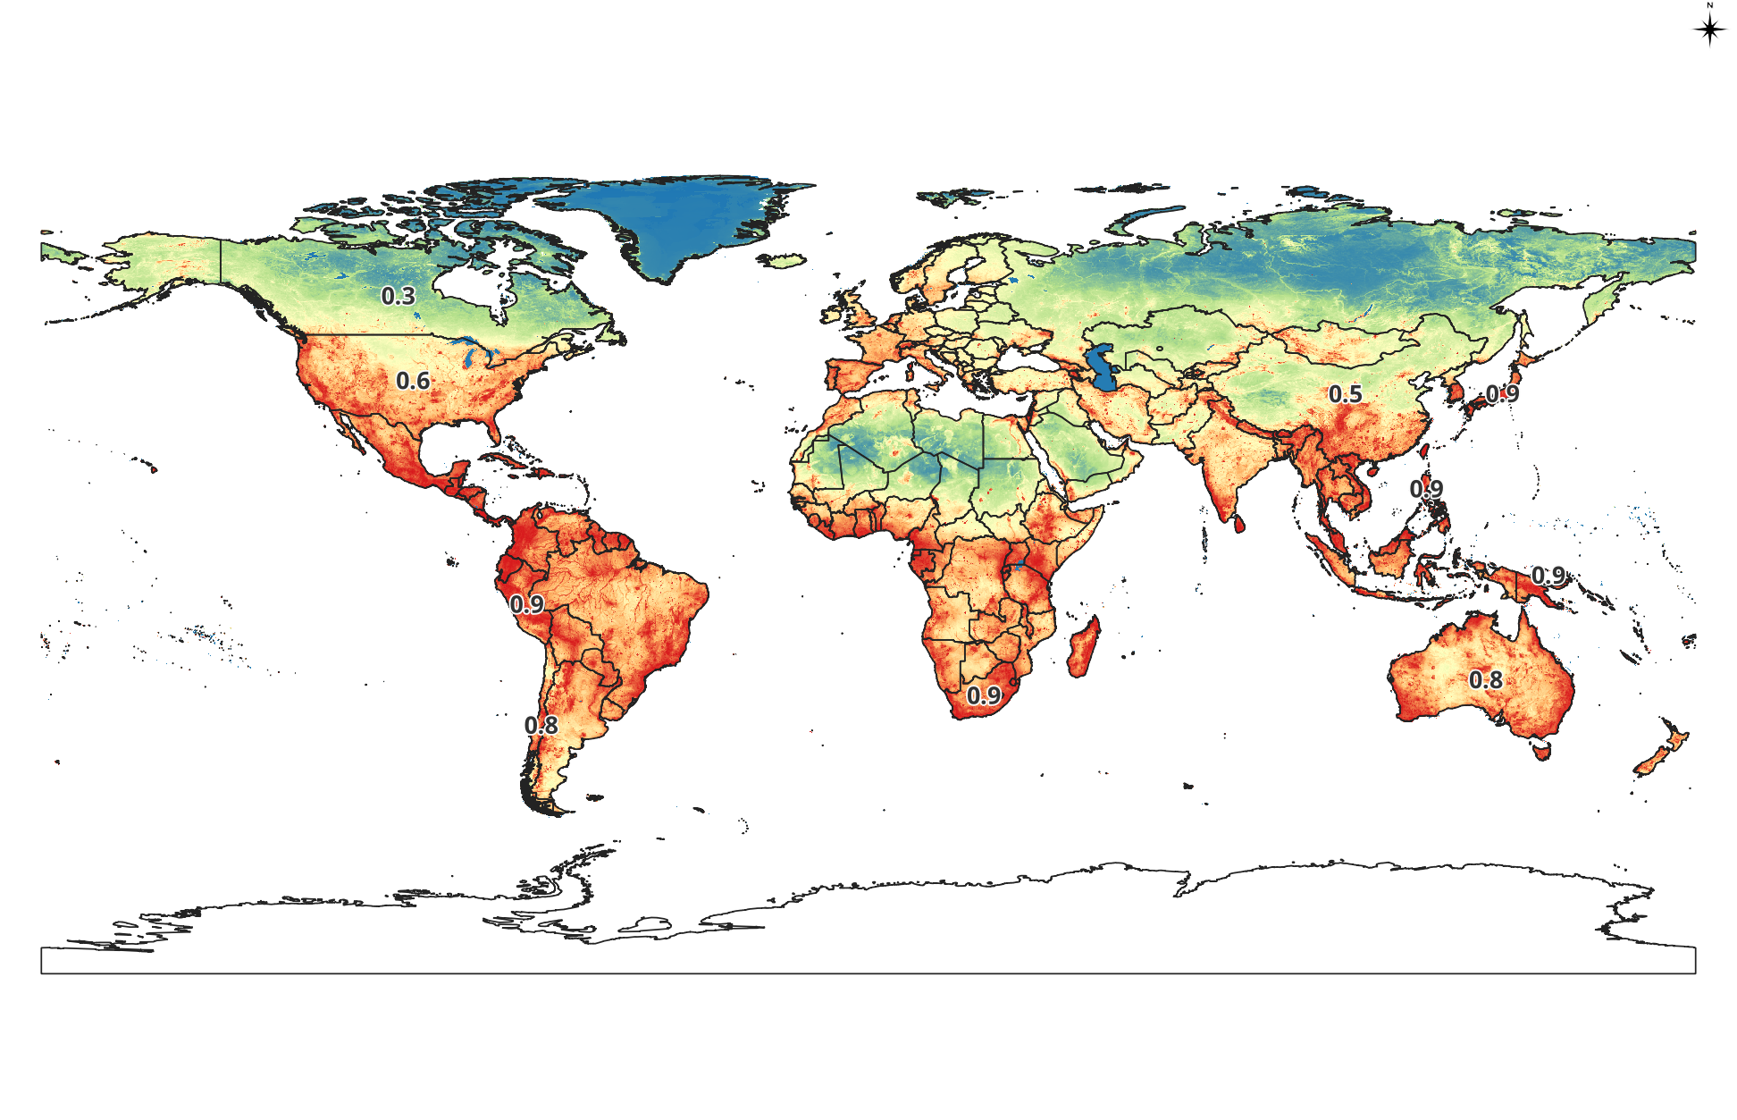
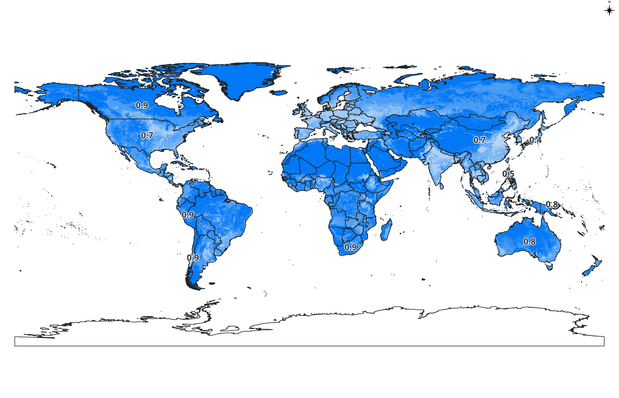
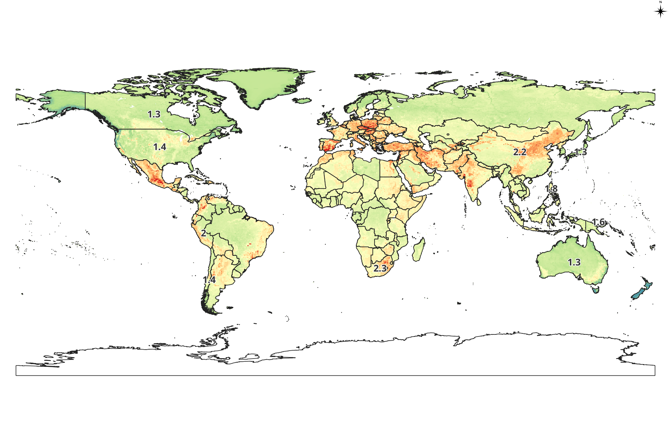
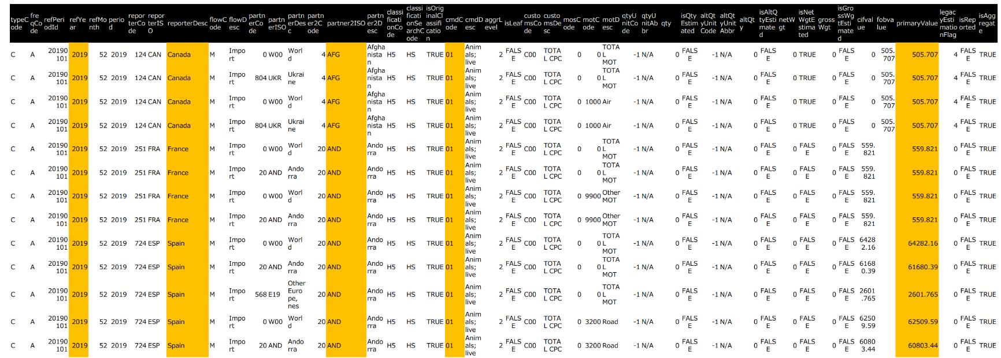
Spatially explicit biodiversity dataset
International
trade dataset by sectors and by countries
https://comtrade.un.org/
Comprehens-ive portfolio analysis
Country-value _{ij}×∑_{ij} PF_at_{ij} / Σ _{ij} PF_ap_{ij}
PF_at_{ij} : Attribution factor
PF_ap_{ij}: Applicable attribution factor

Slide 5
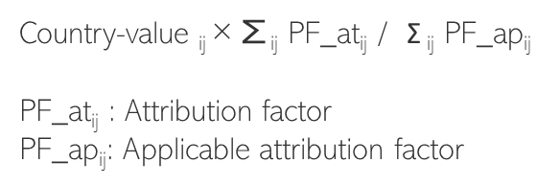
Spatially explicit biodiversity dataset
International
trade dataset by sectors and countries
https://comtrade.un.org/
Comprehensive portfolio analysis

